Slide 1


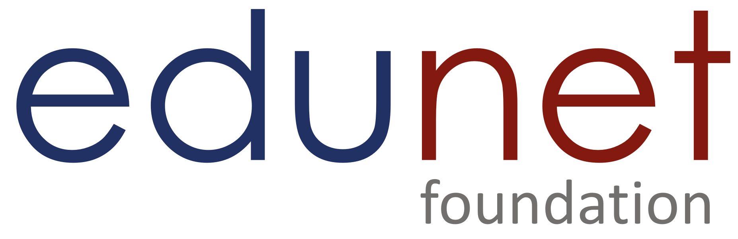

SSSSS
NEXT GEN EMPLOYABILITY PROGRAM
Creating a future-ready workforce
Team Members
College Name
Student Name : AswinKumar R
Student ID :au711021205002
Info institute of engineering

Slide 2

CAPSTONE PROJECT SHOWCASE
Project Title
Notes Sharing Web Application using Django Framework
Abstract | Problem Statement | Project Overview | Proposed Solution | Technology Used | Modelling & Results | Conclusion

Slide 3
Abstract
This project proposes the development of a notes sharing web application using Django, a high-level Python web framework. The application will provide functionalities for users to sign up, log in, and share notes with others. Through a user-friendly interface, individuals can create, edit, and organize their notes, while also having the option to share them securely with other registered users. This project aims to provide a seamless and efficient platform for collaborative note-taking and knowledge sharing.
Source :

Slide 4
Problem Statement
The absence of a convenient and secure platform for sharing notes hinders efficient collaboration and knowledge dissemination among individuals. To address this issue, we aim to develop a notes sharing web application using Django, enabling users to securely sign up, log in, and share their notes with others. This platform will provide a user-friendly interface for creating, editing, and organizing notes, facilitating seamless collaboration and information exchange among users.
Source :

Slide 5
Project Overview
The notes sharing web application using Django with login and signup functionality aims to provide users with a convenient platform for creating, organizing, and sharing notes securely. The application will include user authentication features, allowing users to sign up for an account and log in securely. Once logged in, users can create new notes, edit existing ones, and organize them into categories or folders. Additionally, users will have the ability to share their notes with other registered users, enabling collaboration and knowledge exchange. The project will focus on creating a user-friendly interface and implementing robust security measures to protect user data and ensure a seamless experience for note sharing and collaboration.
Source :

Slide 6
Proposed Solution
.
The proposed solution for the notes sharing web application using Django with login and signup functionality involves developing a secure and user-friendly platform for users to create, organize, and share their notes. The solution will include implementing user authentication features, allowing users to sign up for accounts and log in securely. Upon logging in, users will be able to create new notes, edit existing ones, and categorize them as needed. Additionally, users will have the option to share their notes with other registered users, facilitating collaboration and knowledge sharing. The solution will prioritize simplicity, ease of use, and robust security measures to ensure a seamless and secure note-sharing experience for all users.
Source :

Slide 7


Technology Used
Front-end
Back-end
Source :

Slide 8
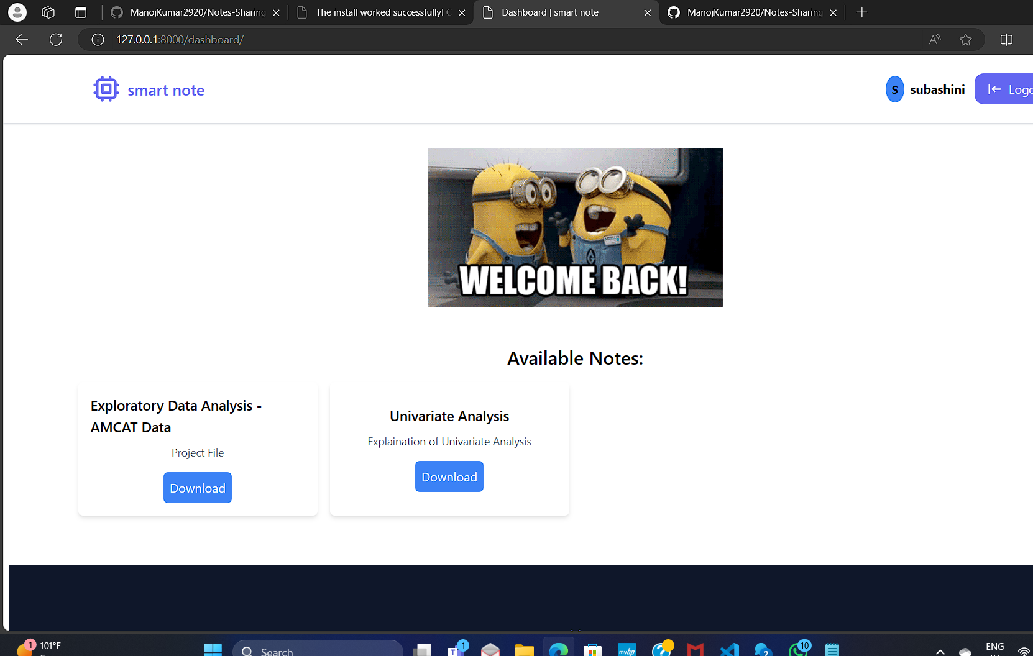
Modelling & Results
Source :

Slide 9
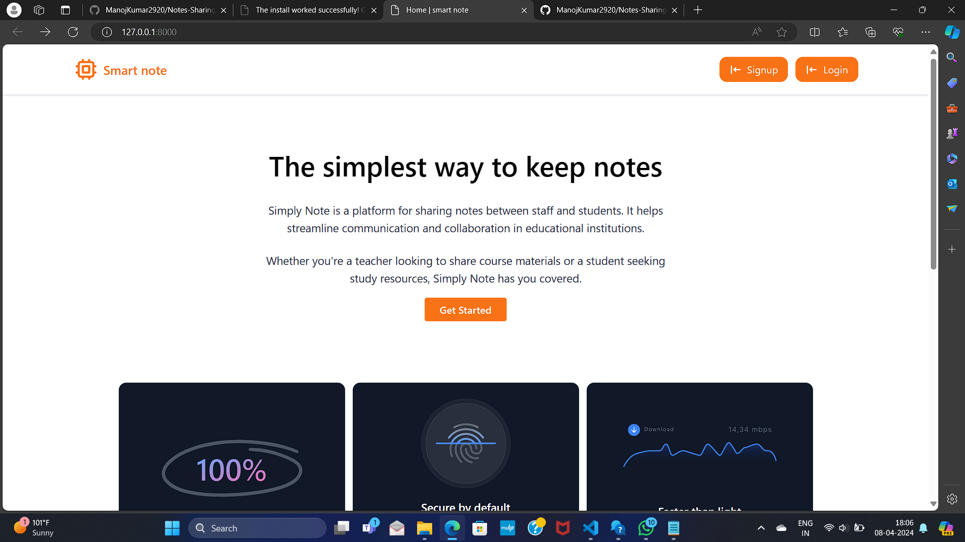
Homepage

Slide 10
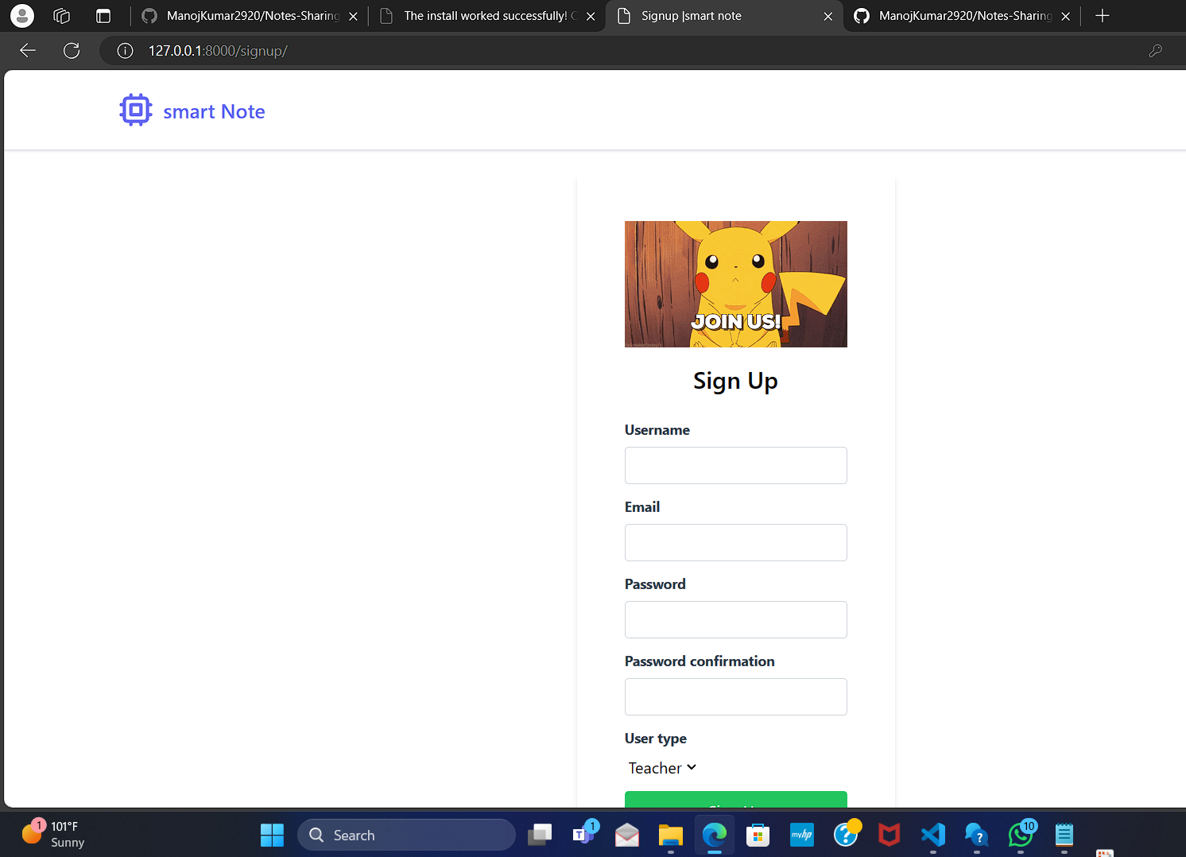
About-Us-Page

Slide 11
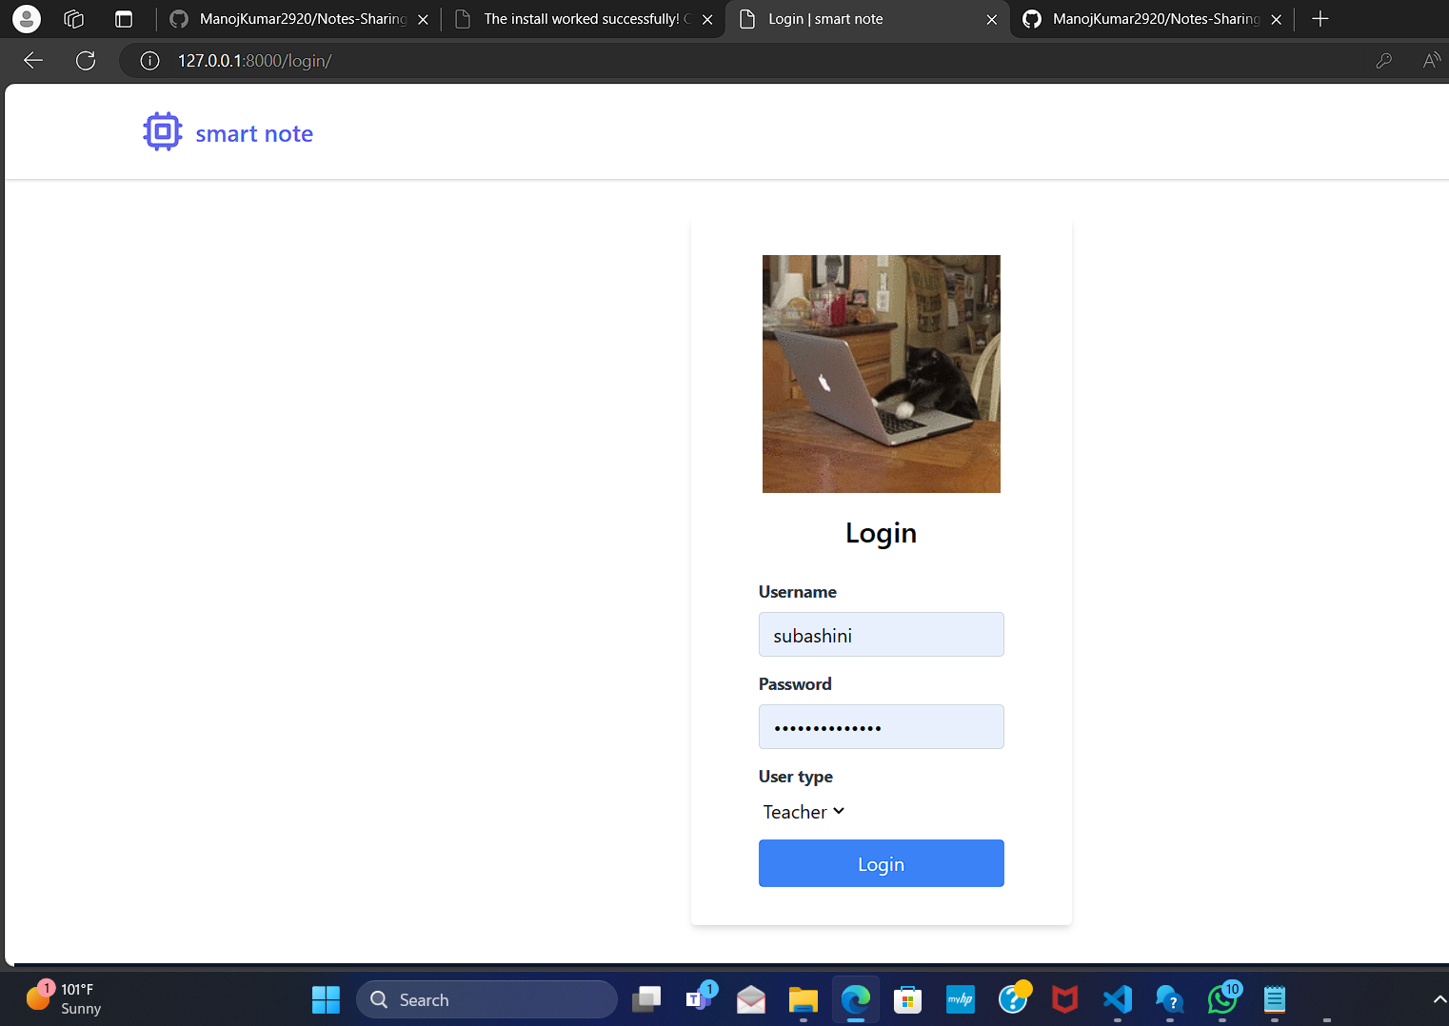
Service-Page

Slide 12
Future Enhancements:
Future enchantments for a notes sharing web application using Django with login and signup refer to additional features and improvements that can be implemented beyond the basic functionality. These enhancements are aimed at improving user experience, increasing functionality, and adding value to the application. They could include features such as real-time collaboration, advanced search capabilities, integration with other platforms, customization options, and more. These enhancements are designed to make the application more robust, versatile, and appealing to users, thereby enhancing its overall utility and attractiveness.

Slide 13
Conclusion
In conclusion, the development of a notes sharing web application using Django with login and signup functionality presents a valuable solution for individuals seeking an efficient and secure platform for collaborative note-taking and knowledge sharing. Through the implementation of user authentication features, users can create accounts securely and access the application's features with confidence. The application's user-friendly interface simplifies the process of creating, editing, organizing, and sharing notes, enhancing productivity and facilitating seamless collaboration among users. Furthermore, the application's robust security measures ensure the protection of user data and privacy. As the application continues to evolve, with future enchantments and enhancements, it will further enhance its utility and appeal to users, making it an indispensable tool for note sharing and collaboration in various contexts.
Source :

Slide 14
Thank You!
Notes:
Thank You !!

